Slide 1
NLP

Slide 2
Text Similarity
Dimensionality Reduction

Slide 3
Issues with Vector Similarity
Polysemy (sim < cos)
bar, bank, jaguar, hot
Synonymy (sim > cos)
building/edifice, large/big, spicy/hot
Relatedness (people are really good at figuring this)
doctor/patient/nurse/treatment

Slide 4
Semantic Matching
Query = “natural language processing”
Document 1 = “linguistics semantics viterbi learning”
Document 2 = “welcome to new haven”
Which one should we rank higher?
Query vocabulary & doc vocabulary mismatch!
If only we can represent documents/queries as concepts!
That’s where dimensionality reduction helps

Slide 5
Semantic Concepts
 | election | vote | president | tomato | salad
NEWS1 | 4 | 4 | 4 | 0 | 0
NEWS2 | 3 | 3 | 3 | 0 | 0
NEWS3 | 1 | 1 | 1 | 0 | 0
NEWS4 | 5 | 5 | 5 | 0 | 0
RECIPE1 | 0 | 0 | 0 | 1 | 1
RECIPE2 | 0 | 0 | 0 | 4 | 4
RECIPE3 | 0 | 0 | 0 | 1 | 1

Slide 6
Semantic Concepts
 | election | vote | president | tomato | salad
NEWS1 | 4 | 4 | 4 | 0 | 0
NEWS2 | 3 | 3 | 3 | 0 | 0
NEWS3 | 1 | 1 | 1 | 0 | 0
NEWS4 | 5 | 5 | 5 | 0 | 0
RECIPE1 | 0 | 0 | 0 | 1 | 1
RECIPE2 | 0 | 0 | 0 | 4 | 4
RECIPE3 | 0 | 0 | 0 | 1 | 1

Slide 7
Concept Space = Dimension Reduction
Number of concepts (K) is smaller than the number of words (N) or number of documents (M).
If we represent a document as a N-dimensional vector; and the corpus as an M*N matrix…
The goal is to reduce the dimensionality from N to K.
But how can we do that?

Slide 8
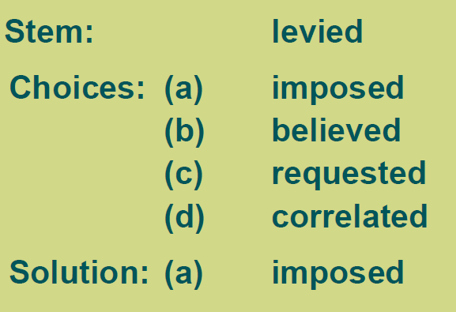
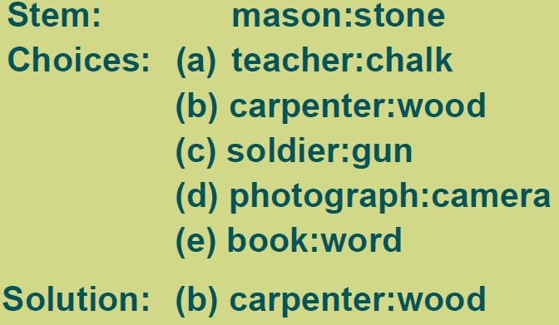
TOEFL Synonyms and SAT Analogies
Word similarity vs. analogies
Example from Peter Turney

Slide 9
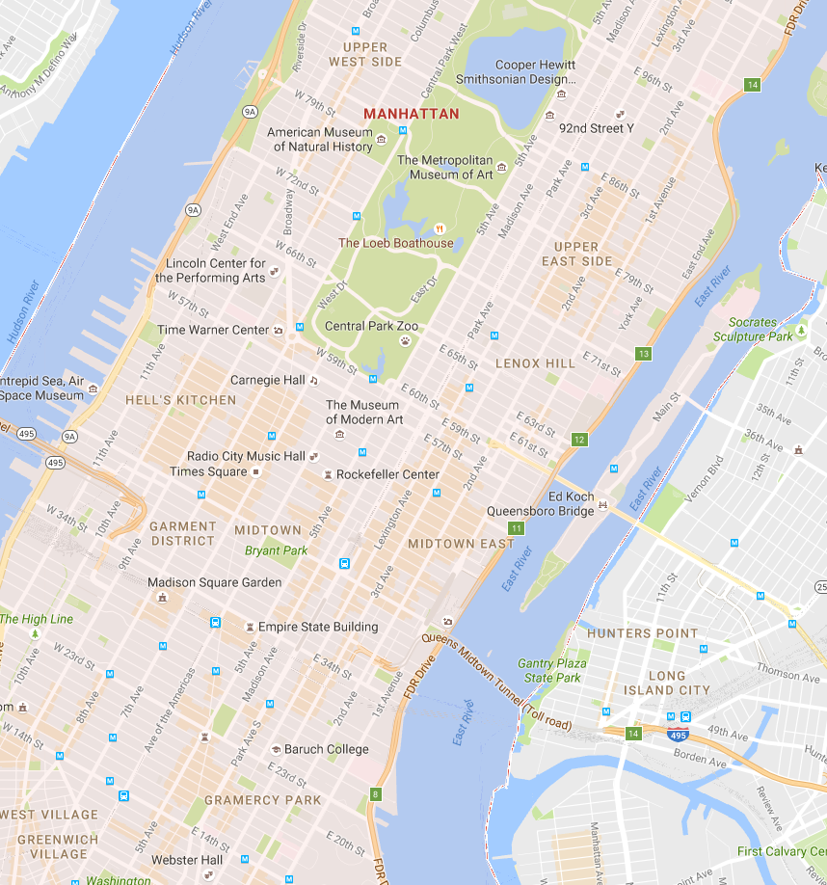

Slide 10
29 degrees

Slide 11
29 degrees

Slide 12

Vectors and Matrices
A matrix is an m x n table of objects (in our case, numbers)
Each row (or column) is a vector.
Matrices of compatible dimensions can be multiplied together.
What is the result of the multiplication below?
$$\left[\begin{matrix}1 & 2 & 4 \\ 2 & 5 & 7 \\ 4 & 9 & 14\end{matrix}\right]\left[\begin{matrix}2 \\ 1 \\ −1\end{matrix}\right]=\left[\begin{matrix} \\ \\ \end{matrix}\right]$$

Slide 13
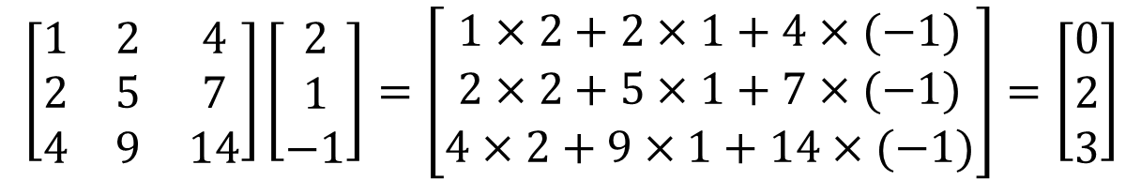
Answer to the Quiz
$$\left[\begin{matrix}1 & 2 & 4 \\ 2 & 5 & 7 \\ 4 & 9 & 14\end{matrix}\right]\left[\begin{matrix}2 \\ 1 \\ −1\end{matrix}\right]=\left[\begin{matrix}1×2+2×1+4×(−1) \\ 2×2+5×1+7×(−1) \\ 4×2+9×1+14×(−1)\end{matrix}\right]=\left[\begin{matrix}0 \\ 2 \\ 3\end{matrix}\right]$$

Slide 14
Eigenvectors and Eigenvalues
An eigenvector is an implicit “direction” for a matrix A
v (the eigenvector) is non-zero
λ (the eigenvalue) can be any complex number, in principle.
Computing eigenvalues:

Slide 15
Eigenvectors and Eigenvalues
Example:
det (A-λI) = (-1-λ)*(-λ)-3*2=0
Then: λ+λ²-6=0; λ₁=2; λ₂=-3
For λ₁=2:
Solutions: v₁=v₂

Slide 16
Matrix decomposition
If Σ is a square matrix, it can be decomposed into UΛU⁻¹, where
U = matrix of eigenvectors
Λ = diagonal matrix of eigenvalues
ΣU = UΛ
U⁻¹ΣU = Λ
Σ = UΛU⁻¹

Slide 17
Example

Slide 18
SVD: Singular Value Decomposition
A=UΣV^{T}
U is the matrix of orthogonal eigenvectors of AA^{T}
V is the matrix of orthogonal eigenvectors of A^{T}A (co-variance matrix)
The components of Σ are the eigenvalues of A^{T}A
Properties
This decomposition exists for all matrices and is unique
U, V are column orthonormal
U^{T} U = I; V^{T} V = I
Σ is diagonal and sorted by absolute value of the singular values (large to small)
Each column (row) of Σ corresponds to a principal component
If A has 5 columns and 3 rows, then U will be 5x5 and V will be 3x3

Slide 19
Example (Berry and Browne)
T1: baby
T2: child
T3: guide
T4: health
T5: home
T6: infant
T7: proofing
T8: safety
T9: toddler
D1: infant & toddler first aid
D2: babies & children’s room (for your home)
D3: child safety at home
D4: your baby’s health and safety: from infant to toddler
D5: baby proofing basics
D6: your guide to easy rust proofing
D7: beanie babies collector’s guide
Notes:
REPLACE
9 TERMS
7 DOCUMENTS

Slide 20
Example
D1: T6, T9
D2: T1, T2
D3: T2, T5, T8
D4: T1, T4, T6, T8, T9
D5: T1, T7
D6: T3, T7
D7: T1, T3
Notes:
REPLACE
9 TERMS
7 DOCUMENTS

Slide 21
Example
T1
D1
T2
D1: T6, T9
D2: T1, T2
D3: T2, T5, T8
D4: T1, T4, T6, T8, T9
D5: T1, T7
D6: T3, T7
D7: T1, T3
D2
T3
D3
T4
D4
T5
D5
T6
D6
T7
D7
T8
T9
Notes:
REPLACE
9 TERMS
7 DOCUMENTS

Slide 22
Document-Term Matrix
raw
normalized

Slide 23
SVD Decomposition
u =
[[-0.70 -0.09 0.02 -0.70 0.00 0.02 0.14 -0.00 0.00]
[-0.26 0.30 0.47 0.20 0.00 -0.25 -0.16 -0.64 0.31]
[-0.35 -0.45 -0.10 0.40 0.71 -0.01 -0.05 0.00 0.00]
[-0.11 0.14 -0.15 -0.07 -0.00 0.48 -0.84 0.00 -0.00]
[-0.26 0.30 0.47 0.20 0.00 -0.25 -0.16 0.64 -0.31]
[-0.19 0.37 -0.50 0.13 0.00 -0.23 0.03 -0.31 -0.64]
[-0.35 -0.45 -0.10 0.40 -0.71 -0.01 -0.05 -0.00 0.00]
[-0.21 0.33 0.10 0.28 0.00 0.73 0.47 -0.00 0.00]
[-0.19 0.37 -0.50 0.13 0.00 -0.23 0.03 0.31 0.64]]
v’ =
[[-0.17 -0.45 -0.27 -0.40 -0.47 -0.32 -0.47]
[ 0.42 0.23 0.42 0.40 -0.30 -0.50 -0.30]
[-0.60 0.46 0.50 -0.39 -0.05 -0.12 -0.05]
[ 0.23 -0.22 0.49 -0.13 -0.26 0.71 -0.26]
[ 0.00 0.00 0.00 0.00 -0.71 -0.00 0.71]
[-0.57 -0.49 0.25 0.61 0.01 -0.02 0.01]
[ 0.24 -0.50 0.45 -0.37 0.34 -0.35 0.34]]

Slide 24
SVD Decomposition
S =
[[ 1.58 0.00 0.00 0.00 0.00 0.00 0.00]
[ 0.00 1.27 0.00 0.00 0.00 0.00 0.00]
[ 0.00 0.00 1.19 0.00 0.00 0.00 0.00]
[ 0.00 0.00 0.00 0.80 0.00 0.00 0.00]
[ 0.00 0.00 0.00 0.00 0.71 0.00 0.00]
[ 0.00 0.00 0.00 0.00 0.00 0.57 0.00]
[ 0.00 0.00 0.00 0.00 0.00 0.00 0.20]
[ 0.00 0.00 0.00 0.00 0.00 0.00 0.00]
[ 0.00 0.00 0.00 0.00 0.00 0.00 0.00]]

Slide 25
SVD Decomposition
u*S*v’ =
[[ 0.00 0.58 0.00 0.45 0.71 0.00 0.71]
[ 0.00 0.58 0.58 0.00 0.00 0.00 0.00]
[ 0.00 0.00 0.00 0.00 0.00 0.71 0.71]
[ 0.00 0.00 0.00 0.45 0.00 0.00 0.00]
[ 0.00 0.58 0.58 0.00 0.00 0.00 0.00]
[ 0.71 0.00 0.00 0.45 0.00 0.00 0.00]
[ 0.00 0.00 0.00 0.00 0.71 0.71 0.00]
[ 0.00 0.00 0.58 0.45 0.00 0.00 0.00]]

Slide 26
Dimensionality Reduction
Low rank matrix approximation
A_{[m*n]} = U_{[m*m]}Σ_{[m*n]}V^{T}_{[n*n]}
Σ is a diagonal matrix of eigenvalues
If we only keep the largest r eigenvalues
A ≈ U_{[m*r]}Σ_{[r*r]}V^{T}_{[n*r]}

Slide 27
Rank-4 Approximation of Σ
S =
[[ 1.58 0.00 0.00 0.00 0.00 0.00 0.00]
[ 0.00 1.27 0.00 0.00 0.00 0.00 0.00]
[ 0.00 0.00 1.19 0.00 0.00 0.00 0.00]
[ 0.00 0.00 0.00 0.80 0.00 0.00 0.00]
[ 0.00 0.00 0.00 0.00 0.00 0.00 0.00]
[ 0.00 0.00 0.00 0.00 0.00 0.00 0.00]
[ 0.00 0.00 0.00 0.00 0.00 0.00 0.00]
[ 0.00 0.00 0.00 0.00 0.00 0.00 0.00]
[ 0.00 0.00 0.00 0.00 0.00 0.00 0.00]]

Slide 28
Rank-4 Approximation of A
u*S*v’ =
[[ 0.00 0.58 0.00 0.45 0.71 0.00 0.71]
[ 0.00 0.58 0.58 0.00 0.00 0.00 0.00]
[ 0.00 0.00 0.00 0.00 0.00 0.71 0.71]
[ 0.00 0.00 0.00 0.45 0.00 0.00 0.00]
[ 0.00 0.58 0.58 0.00 0.00 0.00 0.00]
[ 0.71 0.00 0.00 0.45 0.00 0.00 0.00]
[ 0.00 0.00 0.00 0.00 0.71 0.71 0.00]
[ 0.00 0.00 0.58 0.45 0.00 0.00 0.00]
u*S4*v’ =
[[-0.00 0.60 -0.01 0.45 0.70 0.01 0.70]
[-0.07 0.49 0.63 0.07 0.01 -0.01 0.01]
[ 0.00 -0.01 0.01 -0.00 0.36 0.70 0.36]
[ 0.20 0.05 0.01 0.22 0.05 -0.05 0.05]
[-0.07 0.49 0.63 0.07 0.01 -0.01 0.01]
[ 0.63 -0.06 0.03 0.53 -0.00 0.00 -0.00]
[ 0.00 -0.01 0.01 -0.00 0.36 0.70 0.36]
[ 0.22 0.25 0.43 0.23 -0.04 0.04 -0.04]
[ 0.63 -0.06 0.03 0.53 -0.00 0.00 -0.00]]

Slide 29
Rank-2 Approximation of Σ
S =
[[ 1.58 0.00 0.00 0.00 0.00 0.00 0.00]
[ 0.00 1.27 0.00 0.00 0.00 0.00 0.00]
[ 0.00 0.00 0.00 0.00 0.00 0.00 0.00]
[ 0.00 0.00 0.00 0.00 0.00 0.00 0.00]
[ 0.00 0.00 0.00 0.00 0.00 0.00 0.00]
[ 0.00 0.00 0.00 0.00 0.00 0.00 0.00]
[ 0.00 0.00 0.00 0.00 0.00 0.00 0.00]
[ 0.00 0.00 0.00 0.00 0.00 0.00 0.00]
[ 0.00 0.00 0.00 0.00 0.00 0.00 0.00]]

Slide 30
Rank-2 Approximation of A
u*S*v’ =
[[ 0.00 0.58 0.00 0.45 0.71 0.00 0.71]
[ 0.00 0.58 0.58 0.00 0.00 0.00 0.00]
[ 0.00 0.00 0.00 0.00 0.00 0.71 0.71]
[ 0.00 0.00 0.00 0.45 0.00 0.00 0.00]
[ 0.00 0.58 0.58 0.00 0.00 0.00 0.00]
[ 0.71 0.00 0.00 0.45 0.00 0.00 0.00]
[ 0.00 0.00 0.00 0.00 0.71 0.71 0.00]
[ 0.00 0.00 0.58 0.45 0.00 0.00 0.00]
u*S2*v’ =
[[ 0.14 0.47 0.25 0.39 0.55 0.41 0.55]
[ 0.23 0.27 0.27 0.31 0.08 -0.06 0.08]
[-0.14 0.12 -0.09 -0.01 0.43 0.46 0.43]
[ 0.10 0.12 0.12 0.14 0.03 -0.03 0.03]
[ 0.23 0.27 0.27 0.31 0.08 -0.06 0.08]
[ 0.25 0.24 0.28 0.31 -0.00 -0.14 -0.00]
[-0.14 0.12 -0.09 -0.01 0.43 0.46 0.43]
[ 0.23 0.24 0.27 0.30 0.03 -0.11 0.03]
[ 0.25 0.24 0.28 0.31 -0.00 -0.14 -0.00]]

Slide 31
Rank-2 Representation
u*S2 =
[[-1.10 -0.12 0.00 0.00 0.00 0.00 0.00]
[-0.41 0.38 0.00 0.00 0.00 0.00 0.00]
[-0.56 -0.57 0.00 0.00 0.00 0.00 0.00]
[-0.18 0.18 0.00 0.00 0.00 0.00 0.00]
[-0.41 0.38 0.00 0.00 0.00 0.00 0.00]
[-0.30 0.47 0.00 0.00 0.00 0.00 0.00]
[-0.56 -0.57 0.00 0.00 0.00 0.00 0.00]
[-0.33 0.42 0.00 0.00 0.00 0.00 0.00]
[-0.30 0.47 0.00 0.00 0.00 0.00 0.00]]
S2*v’ =
[[-0.26 -0.71 -0.42 -0.62 -0.74 -0.50 -0.74]
[ 0.53 0.29 0.54 0.51 -0.38 -0.64 -0.38]
[ 0.00 0.00 0.00 0.00 0.00 0.00 0.00]
[ 0.00 0.00 0.00 0.00 0.00 0.00 0.00]
[ 0.00 0.00 0.00 0.00 0.00 0.00 0.00]
[ 0.00 0.00 0.00 0.00 0.00 0.00 0.00]
[ 0.00 0.00 0.00 0.00 0.00 0.00 0.00]
[ 0.00 0.00 0.00 0.00 0.00 0.00 0.00]
[ 0.00 0.00 0.00 0.00 0.00 0.00 0.00]]

Slide 32
D1 | D2 | D3 | D4 | D5 | D6 | D7
-0.26 | -0.71 | -0.42 | -0.62 | -0.74 | -0.50 | -0.74
0.53 | 0.29 | 0.54 | 0.51 | -0.38 | -0.64 | -0.38
T1 | T2 | T3 | T4 | T5 | T6 | T7 | T8 | T9
-1.10 | -0.41 | -0.56 | -0.18 | -0.41 | -0.30 | -0.56 | -0.33 | -0.30
-0.12 | 0.38 | -0.57 | 0.18 | 0.38 | 0.47 | -0.57 | 0.42 | 0.47
D7
T3,T7
D6

Slide 33
D1 | D2 | D3 | D4 | D5 | D6 | D7
-0.26 | -0.71 | -0.42 | -0.62 | -0.74 | -0.50 | -0.74
0.53 | 0.29 | 0.54 | 0.51 | -0.38 | -0.64 | -0.38
T1 | T2 | T3 | T4 | T5 | T6 | T7 | T8 | T9
-1.10 | -0.41 | -0.56 | -0.18 | -0.41 | -0.30 | -0.56 | -0.33 | -0.30
-0.12 | 0.38 | -0.57 | 0.18 | 0.38 | 0.47 | -0.57 | 0.42 | 0.47
T1
D7
T3,T7
D6

Slide 34
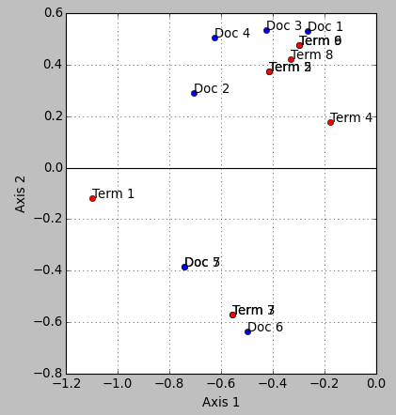

Slide 35
Example
T1
D1
T2
D1: T6, T9
D2: T1, T2
D3: T2, T5, T8
D4: T1, T4, T6, T8, T9
D5: T1, T7
D6: T3, T7
D7: T1, T3
D2
T3
D3
T4
D4
T5
D5
T6
D6
T7
D7
T8
T9
Notes:
There is no explicit link from T7 to D7, but there is a latent link

Slide 36
Semantic Concepts
 | election | vote | president | tomato | salad
NEWS1 | 4 | 4 | 4 | 0 | 0
NEWS2 | 3 | 3 | 3 | 0 | 0
NEWS3 | 1 | 1 | 1 | 0 | 0
NEWS4 | 5 | 5 | 5 | 0 | 0
RECIPE1 | 0 | 0 | 0 | 1 | 1
RECIPE2 | 0 | 0 | 0 | 4 | 4
RECIPE3 | 0 | 0 | 0 | 1 | 1

Slide 37
Semantic Concepts
 | election | vote | president | tomato | salad
NEWS1 | 4 | 4 | 4 | 0 | 0
NEWS2 | 3 | 3 | 3 | 0 | 0
NEWS3 | 1 | 1 | 1 | 0 | 0
NEWS4 | 5 | 5 | 5 | 0 | 0
RECIPE1 | 0 | 0 | 0 | 1 | 1
RECIPE2 | 0 | 0 | 0 | 4 | 4
RECIPE3 | 0 | 0 | 0 | 1 | 1

Slide 38
Adding Noise
 | election | vote | president | tomato | salad
NEWS1 | 4 | 4 | 4 | 0 | 0
NEWS2 | 3 | 0 | 3 | 0 | 2
NEWS3 | 1 | 1 | 1 | 1 | 0
NEWS4 | 5 | 5 | 3 | 0 | 0
RECIPE1 | 0 | 0 | 0 | 1 | 1
RECIPE2 | 0 | 1 | 0 | 4 | 4
RECIPE3 | 0 | 0 | 0 | 0 | 1

Slide 39
Quiz
Let A be a document x term matrix.
What is A*A’?
What about A’*A?
Notes:
EXPLAIN

Slide 40
Interpretation of SVD
Best direction to project on
The principal eigenvector is the dimension that explains most of the variance
Finding hidden concepts
Mapping documents, terms to a lower-dimensional space
Turning the matrix into block-diagonal form
(same as finding bi-partite cores)
In the NLP/IR literature, SVD is called LSA (LSI)
Latent Semantic Analysis (Indexing)
Keep as many dimensions as necessary to explain 80-90% of the data (energy)
In practice, use 300 dimensions or so

Slide 41
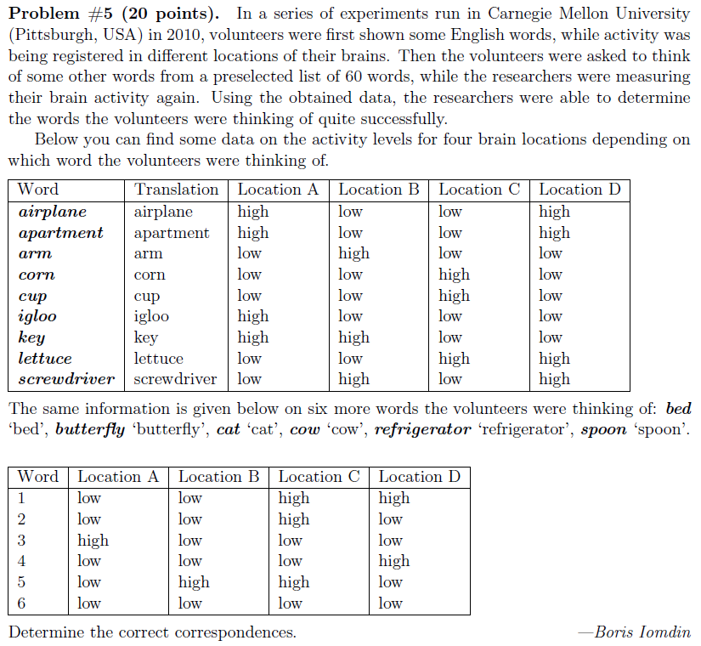

Slide 42
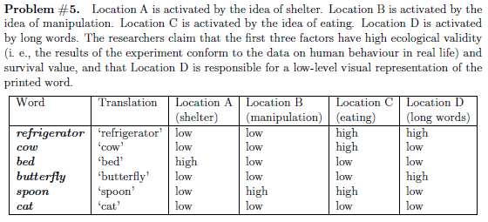

Slide 43
fMRI example
fMRI
functional MRI (magnetic resonance imaging)
Used to measure activity in different parts of the brain when exposed to various stimuli
Factor analysis
Paper
Just, M. A., Cherkassky, V. L., Aryal, S., & Mitchell, T. M. (2010). A neurosemantic theory of concrete noun representation based on the underlying brain codes. PLoS ONE, 5, e8622

Slide 44
[Just et al. 2010]

Slide 45
[Just et al. 2010]

Slide 46
[Just et al. 2010]

Slide 47
External pointers
http://lsa.colorado.edu
http://www.cs.utk.edu/~lsi
Notes:
CHECK LINKS

Slide 48
Example of LSI
A = U Λ V^{T}
retrieval
lung
CS-concept
MD-concept
data
inf
brain
Strength of CS-concept
Dim. Reduction
CS
=
x
x
MD
Term rep of concept
[Example modified from Christos Faloutsos]

Slide 49
Mapping Queries and Docs to the Same Space
q^{T}_{concept} = q^{T} V
d^{T}_{concept} = d^{T} V
CS-concept
Similarity with
CS-concept
retrieval
inf.
lung
data
brain
=
q^{T}=
d^{T}=
0 1 1 0 0
1.16 0
[Example modified from Christos Faloutsos]

Slide 50
NLP

